Slide 1
TO BE FORMS-AM,IS,ARE
Negative Form

Slide 2
TO BE FORMS-AM,IS,ARE
A Quick Review
I am or I’m
He is or He’s
She is or She’s
You are or You’re
We are or We’re
They are or They’re

Slide 3
AM,IS,ARE-NEGATIVE FORM
I am not In short I’m not
He is not In short He’not or He isn’t
She is not In short She’s not or She isn’t
You are not In short You’re not or You aren’t
We are not In short We’re not or We aren’t
They are not In short They’re not or They aren’t

Slide 4
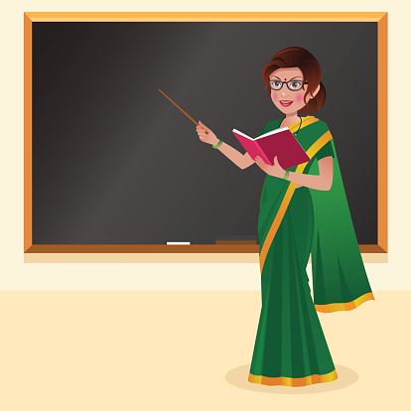

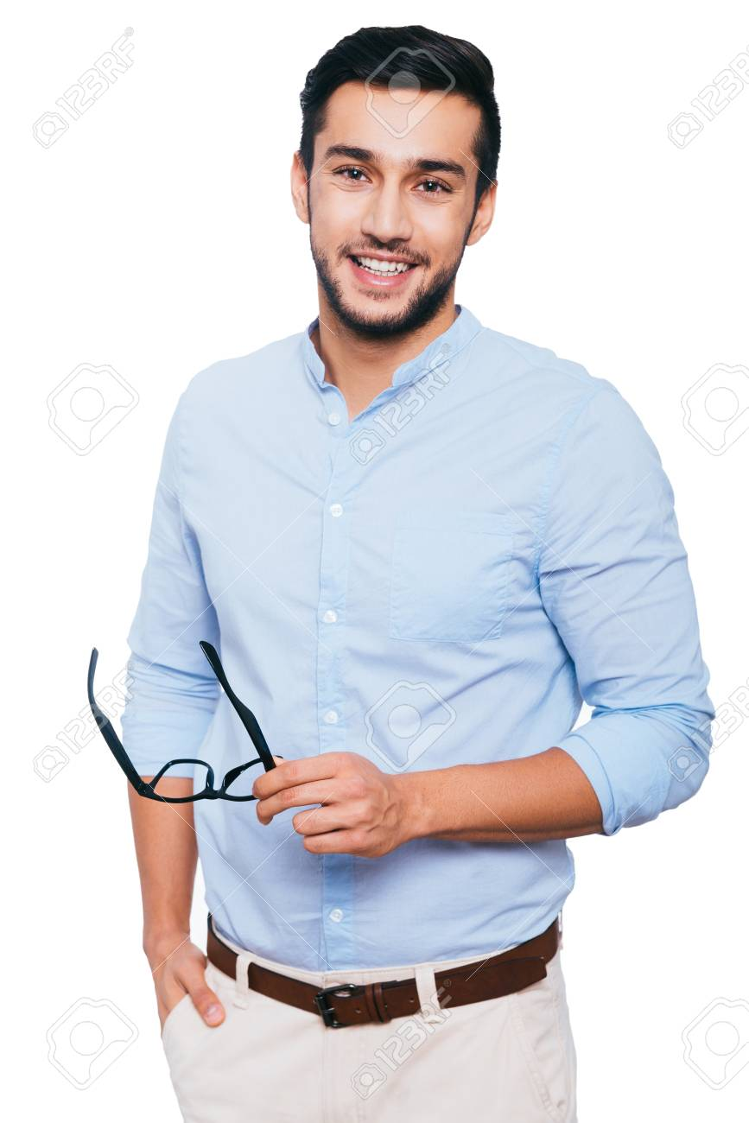
AM,IS,ARE-NEGATIVE FORM
I am a teacher.
I am not a doctor.
She is a student.
She is not employed.
He is single.
He is not married.

Slide 5
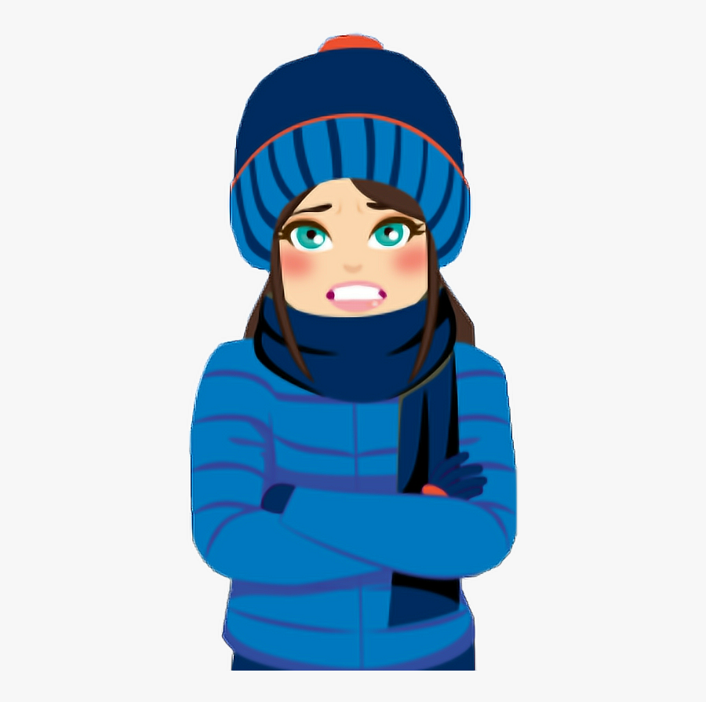
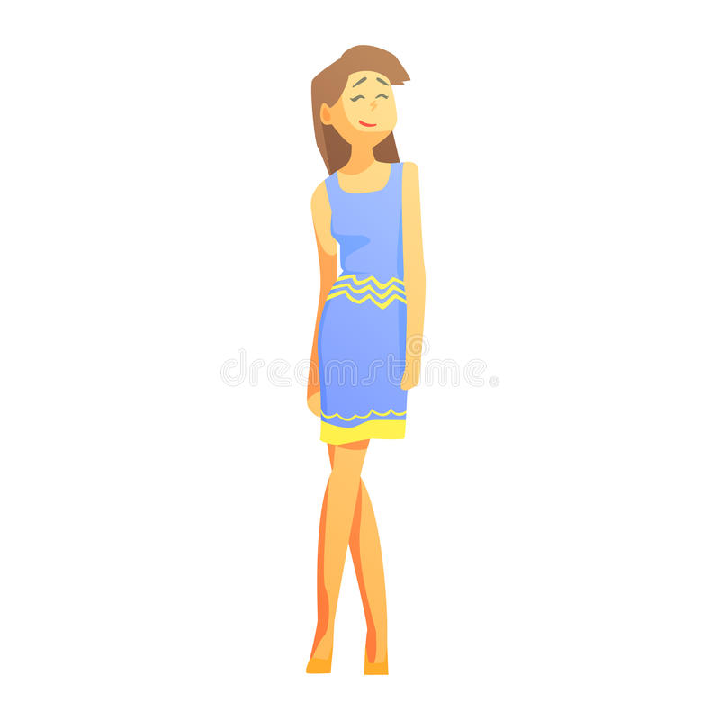

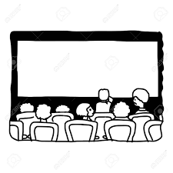
AM,IS,ARE-NEGATIVE FORM
The weather is cold.
It is not hot.
The children are happy.
They are not sad.
She is tall.
She is not short.
The movie is interesting.
It is not boring.

Slide 6
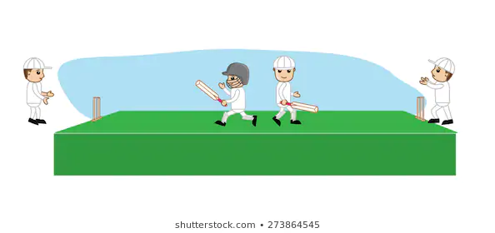
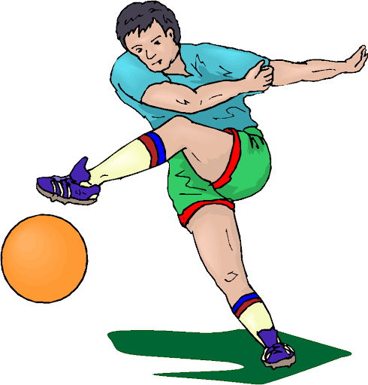

AM,IS,ARE-NEGATIVE FORM
We are in the playground.
We are not at home.
I am interested in football.
I am not interested in cricket.
They are graduates.
They are not post-graduates.

Slide 7
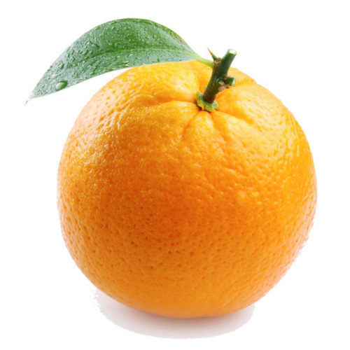

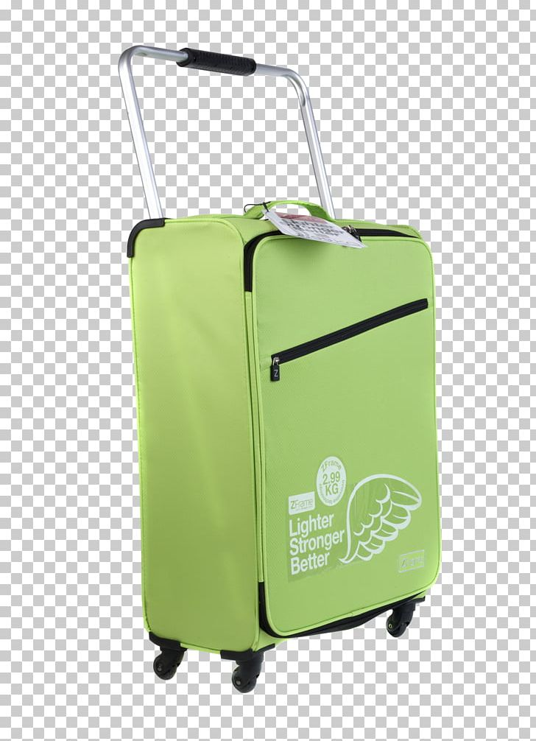
AM,IS,ARE-NEGATIVE FORM
It is an orange.
It is not a mango.
The man is young.
He is not old.
The luggage is light.
It is not heavy.

Slide 8
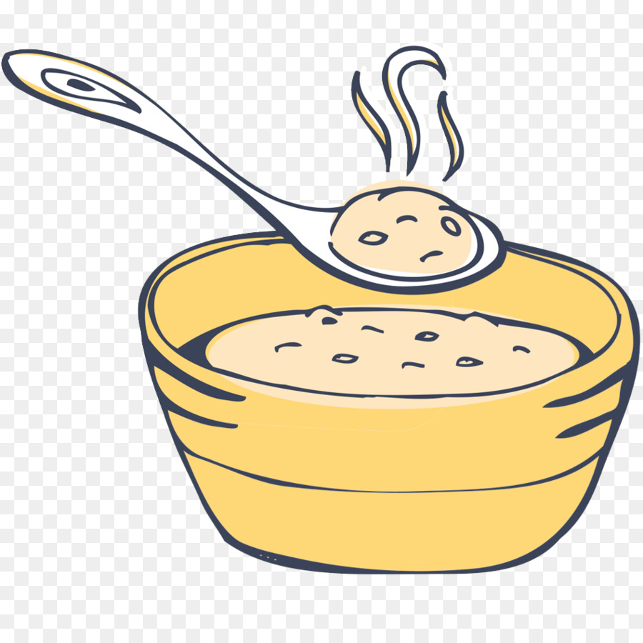


AM,IS,ARE-NEGATIVE FORM
The food is mild.
It is not spicy.
My college is close to my house..
It is not far away.
The shops are closed on Sundays.
They are not open on Sundays.

Slide 9
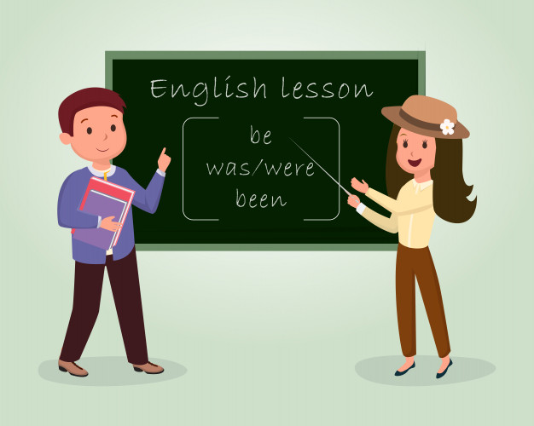
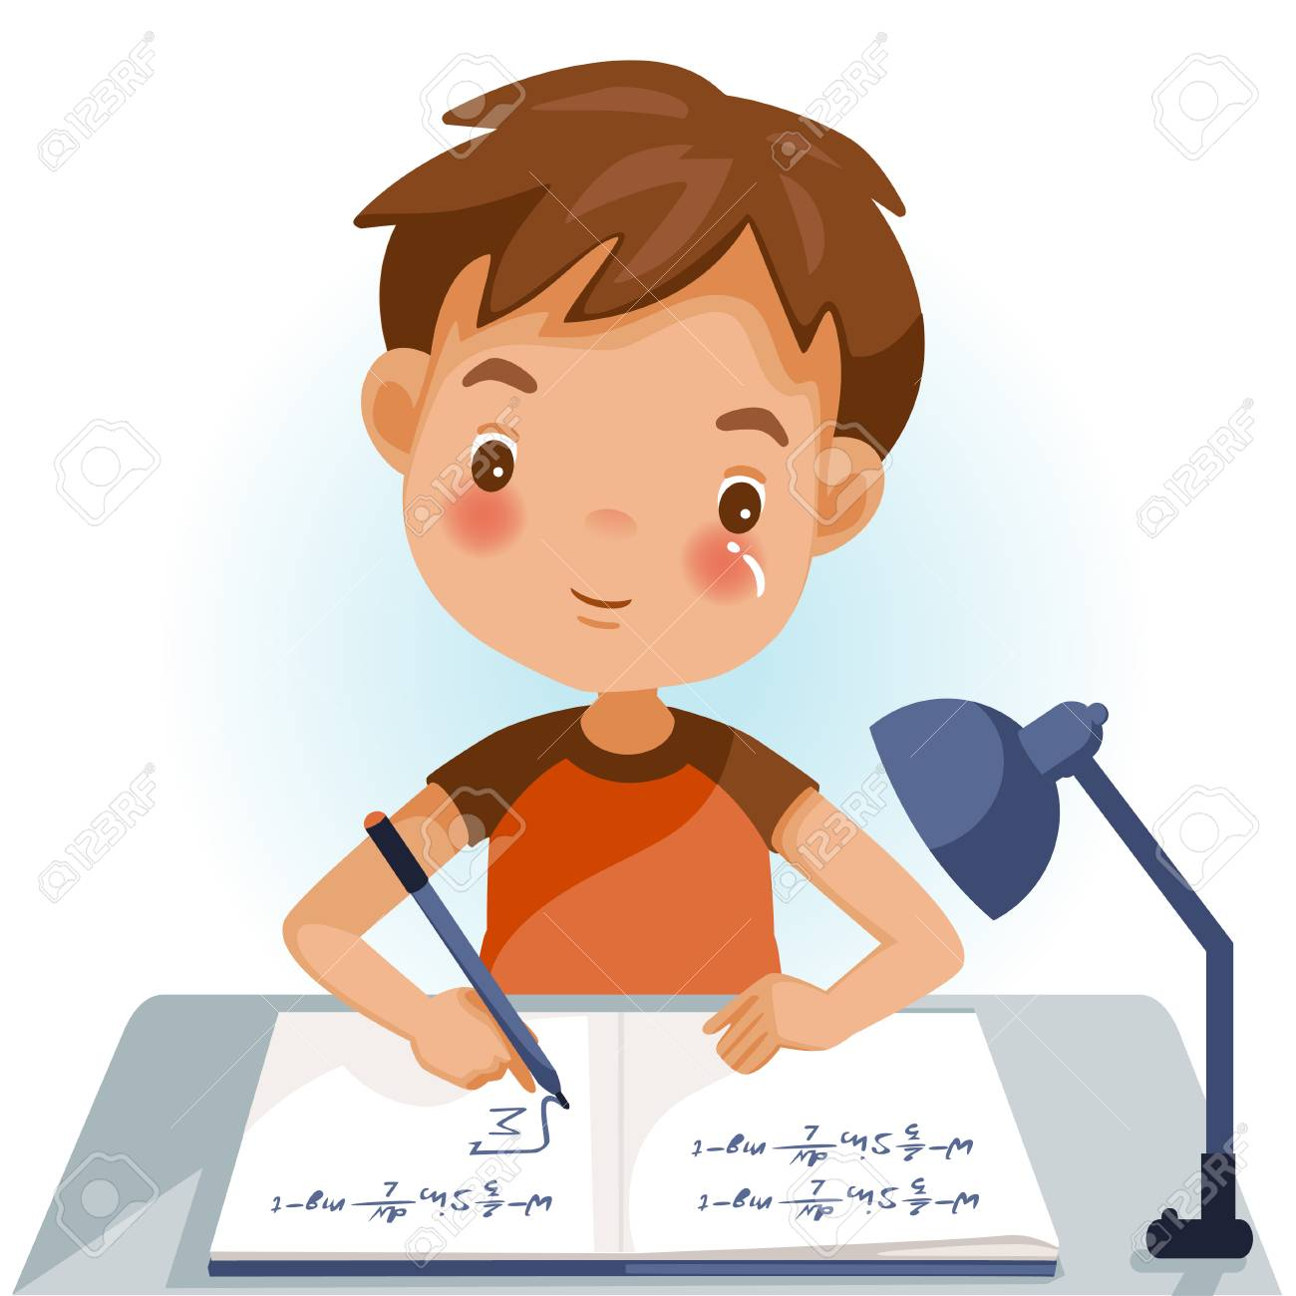
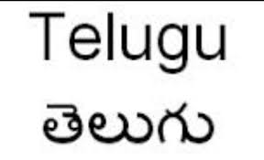
AM,IS,ARE-NEGATIVE FORM
I am learning English now.
I am not listening to music.
Ram is good at Maths.
But he is not good at Science.
My mother tongue is Telugu.
My mother tongue is not Hindi.

Slide 10
AM,IS,ARE-NEGATIVE FORM
Review
He is educated. The doctor is experienced. I am from Hyderabad.
He is not educated. The doctor is not experienced. I am not from Hyderabad.
She is tall. The mangoes are ripe. The traffic is heavy.
She is not tall. The mangoes are not ripe. The traffic is not heavy.
The food is tasty. The students are regular. She is very talkative.
The food is not tasty. The students are not regular. She is not very talkative.
The books are available. The medicine is effective. We are very close friends.
The books are not available. The medicine is not effective. We are not very close friends.

